Slide 1
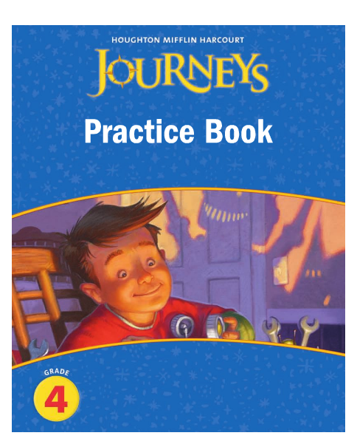
Harcourt Journeys: Spelling
Copyright © 2011 Kelly Mott
Notes:
1

Slide 2
Select Lesson:
Lesson 1 Lesson 8
Lesson 2 Lesson 9
Lesson 3 Lesson 10
Lesson 4 Lesson 11
Lesson 5 Lesson 12
Lesson 6 Lesson 13
Lesson 7 Lesson 14
Copyright © 2011 Kelly Mott

Slide 3
Select Lesson:
Lesson 15 Lesson 22
Lesson 16 Lesson 23
Lesson 17 Lesson 24
Lesson 18 Lesson 25
Lesson 19 Lesson 26
Lesson 20 Lesson 27
Lesson 21 Lesson 28
Copyright © 2011 Kelly Mott

Slide 4
Select Lesson:
Lesson 29
Lesson 30
Copyright © 2011 Kelly Mott

Slide 5
Unit 1: Lesson 1 Spelling
Copyright © 2011 Kelly Mott
Notes:
5

Slide 6
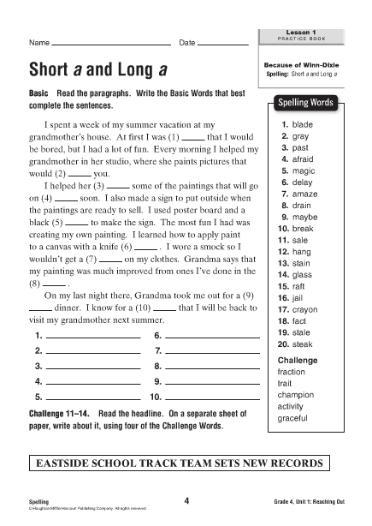

Slide 7
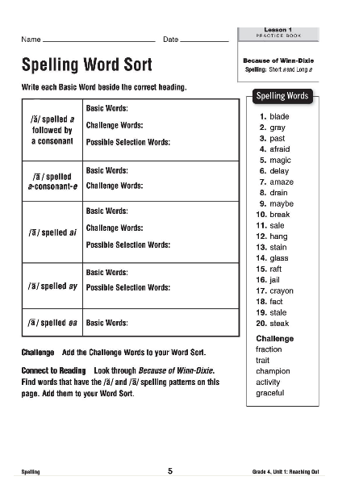

Slide 8
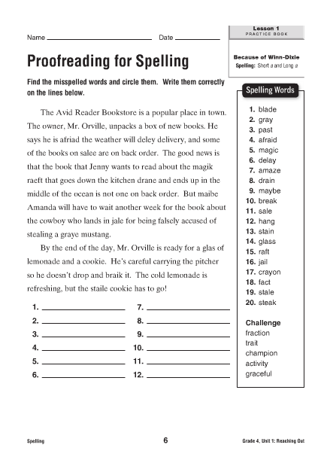

Slide 10
Unit 1: Lesson 2 Spelling
Copyright © 2011 Kelly Mott
Notes:
10

Slide 11
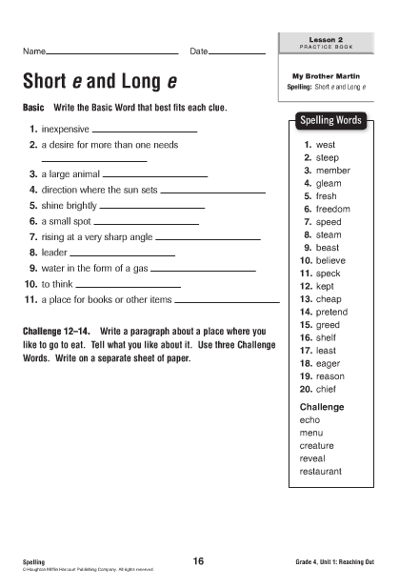

Slide 12
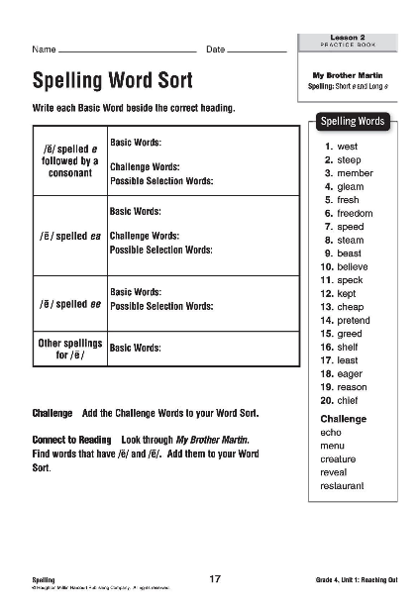

Slide 13
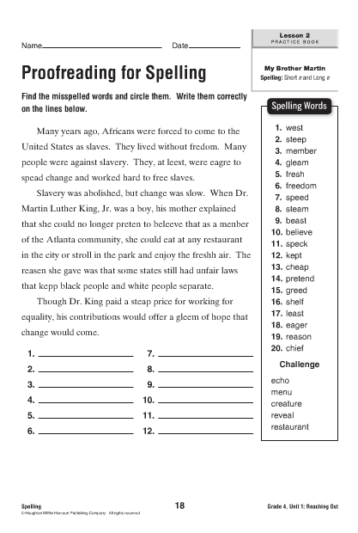

Slide 15
Unit 1: Lesson 3 Spelling
Copyright © 2011 Kelly Mott
Notes:
15

Slide 16
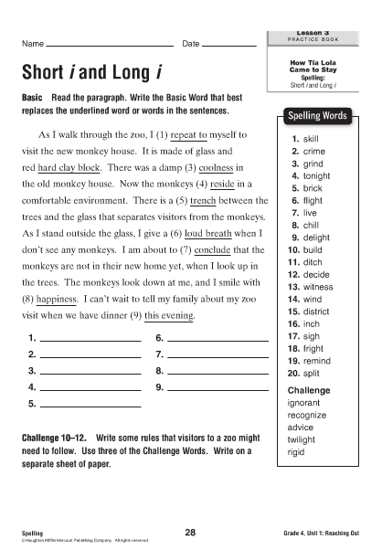

Slide 17
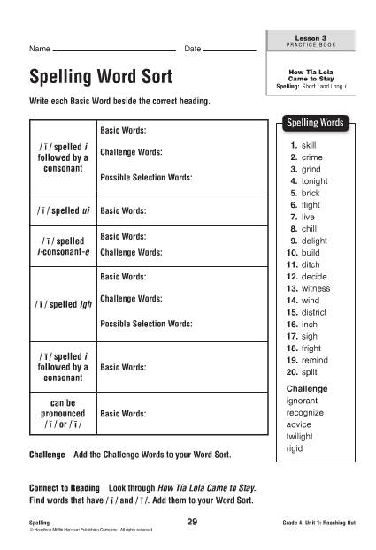

Slide 18
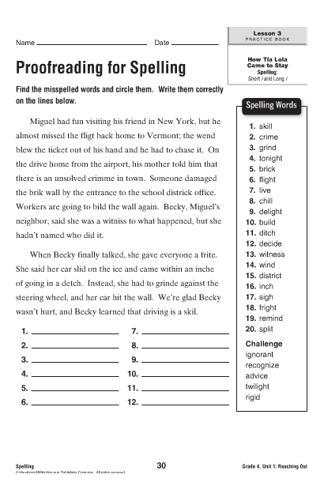

Slide 20
Unit 1: Lesson 4 Spelling
Copyright © 2011 Kelly Mott
Notes:
20

Slide 21
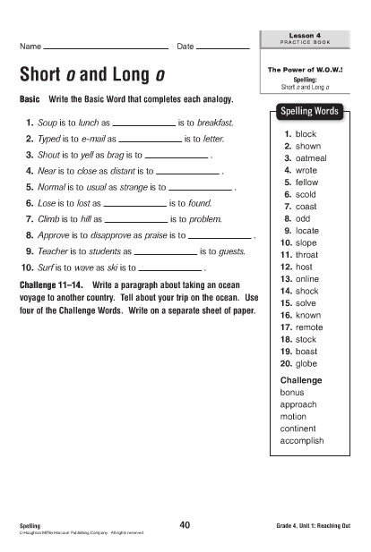

Slide 22
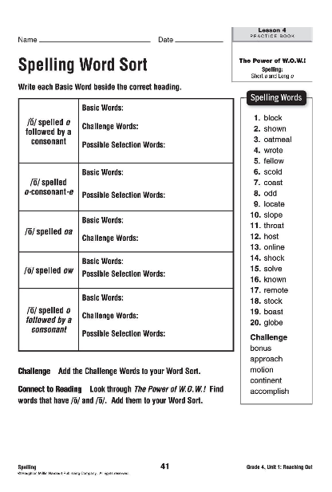

Slide 23
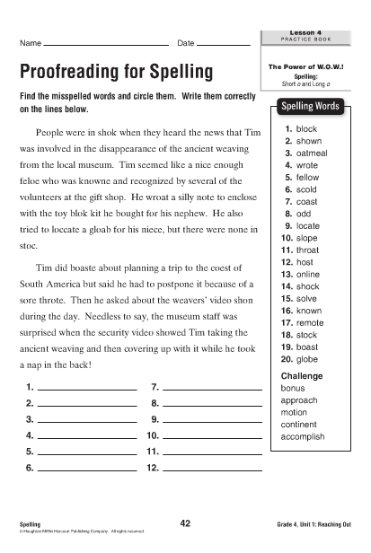

Slide 25
Unit 1: Lesson 5 Spelling
Copyright © 2011 Kelly Mott
Notes:
25

Slide 26
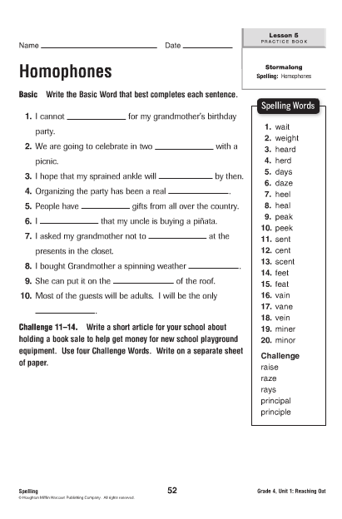

Slide 27
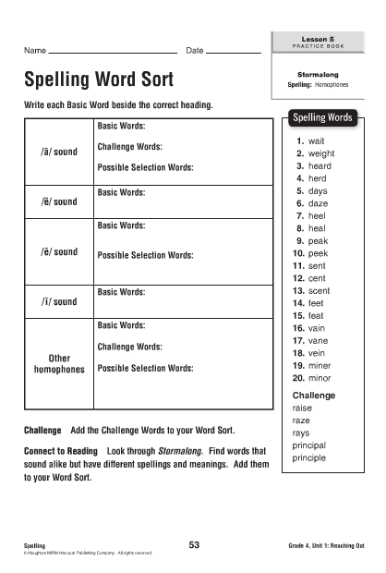

Slide 28
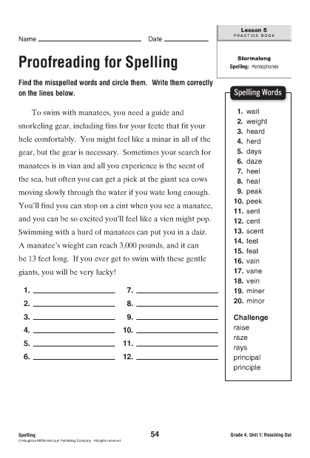

Slide 30
Unit 1: Lesson 6 Spelling
Copyright © 2011 Kelly Mott
Notes:
30

Slide 31
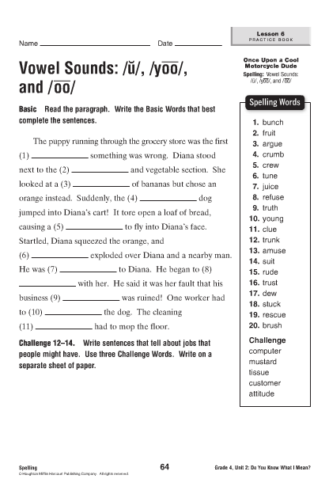

Slide 32
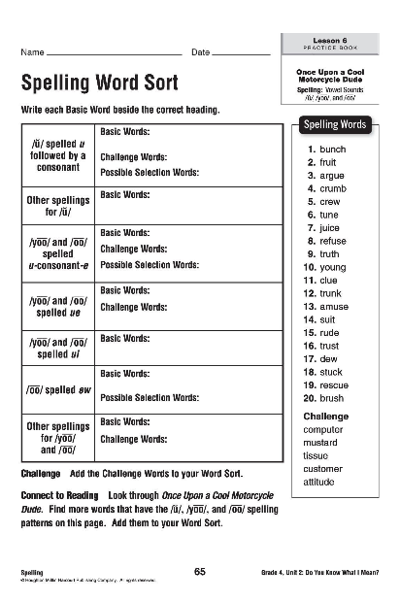

Slide 33
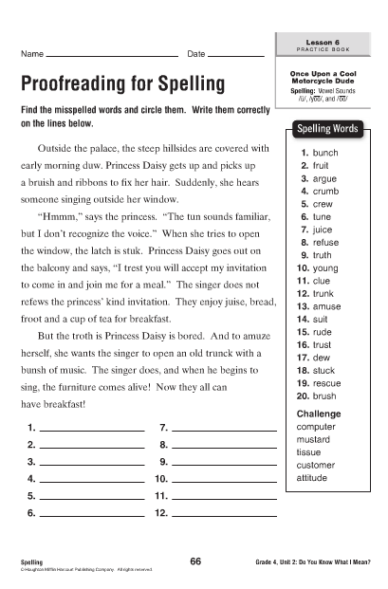

Slide 35
Unit 1: Lesson 7 Spelling
Copyright © 2011 Kelly Mott
Notes:
35

Slide 36
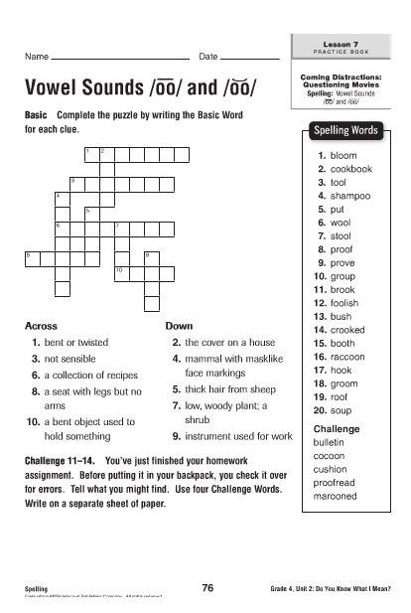

Slide 37
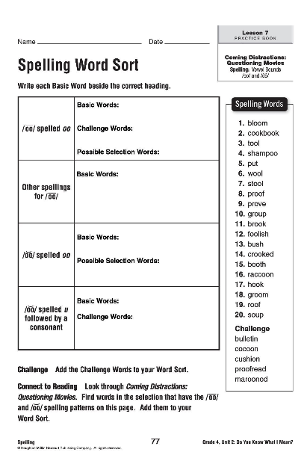

Slide 38
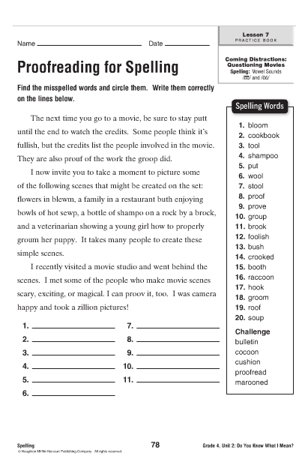

Slide 40
Unit 1: Lesson 8 Spelling
Copyright © 2011 Kelly Mott
Notes:
40

Slide 41
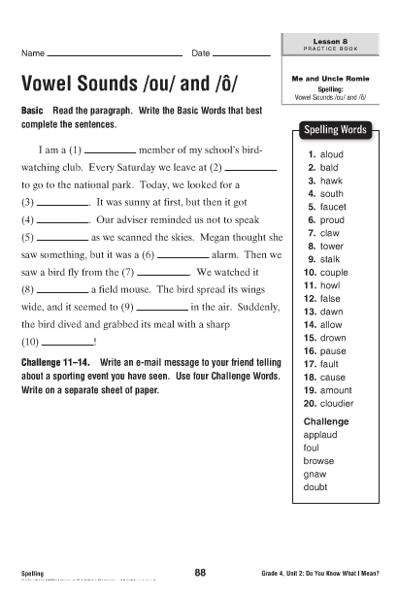

Slide 42
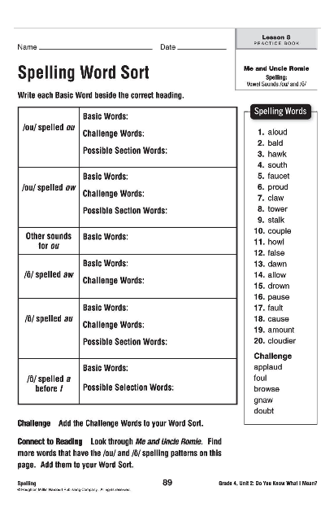

Slide 43
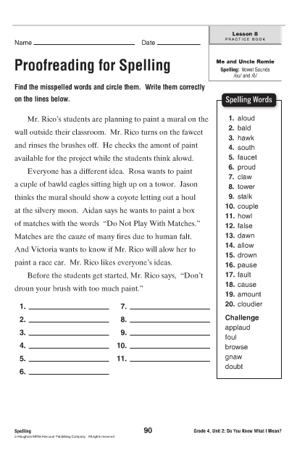

Slide 45
Unit 1: Lesson 9 Spelling
Copyright © 2011 Kelly Mott
Notes:
45

Slide 46
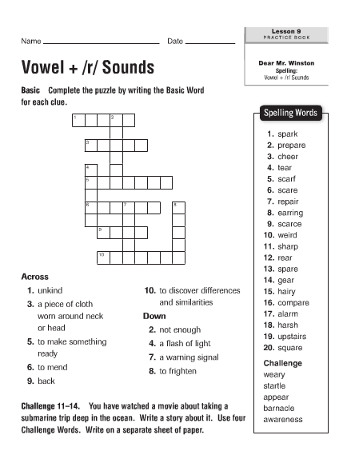

Slide 47
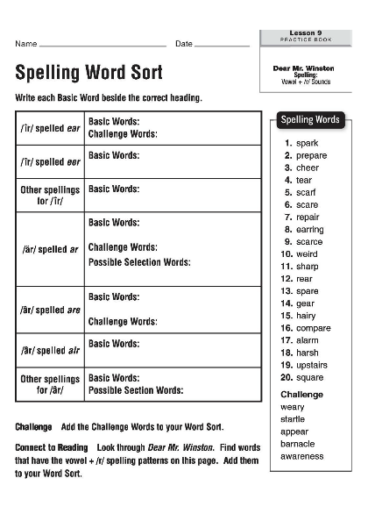

Slide 48
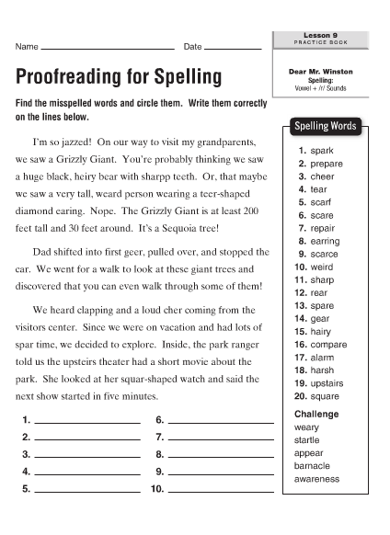

Slide 50
Unit 1: Lesson 10 Spelling
Copyright © 2011 Kelly Mott
Notes:
50

Slide 51
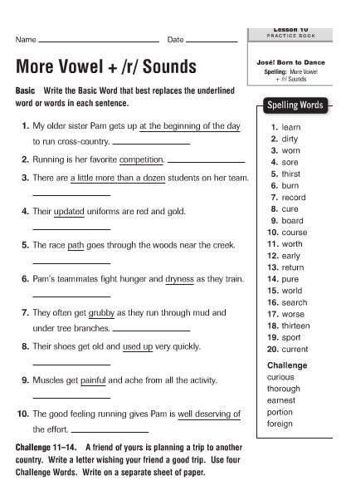

Slide 52
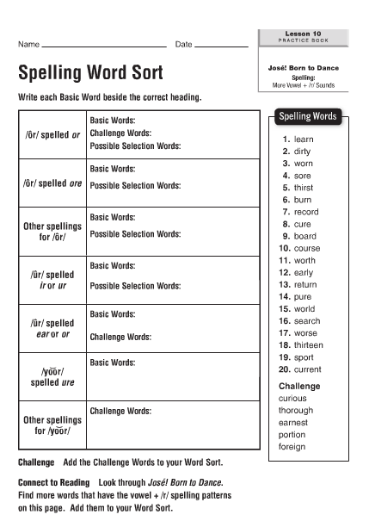

Slide 53
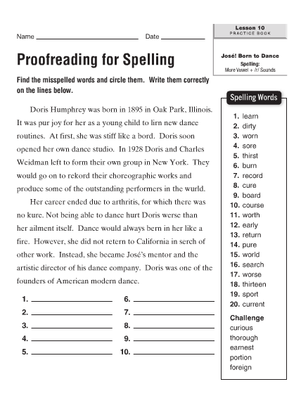

Slide 55
Unit 1: Lesson 11 Spelling
Copyright © 2011 Kelly Mott
Notes:
55

Slide 56
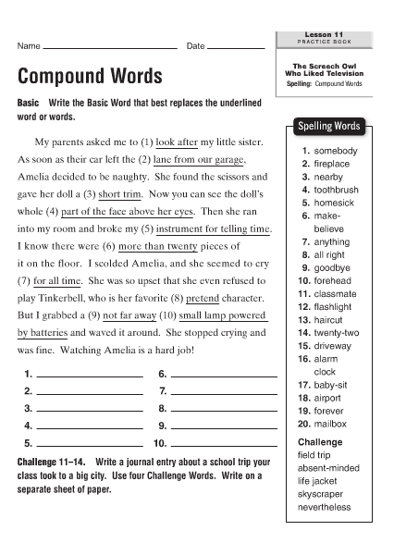

Slide 57
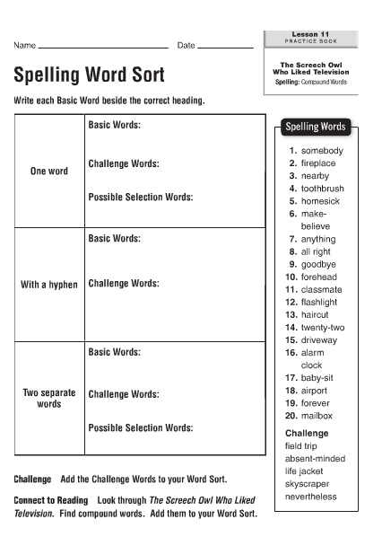

Slide 58
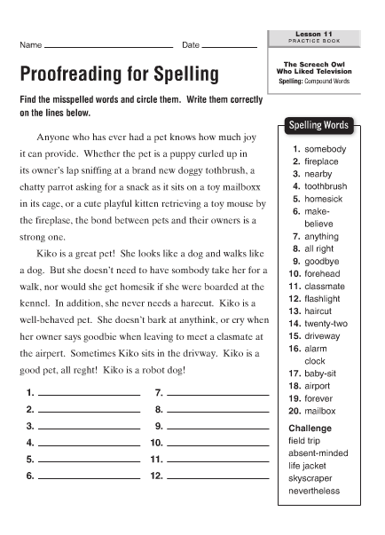

Slide 60
Unit 1: Lesson 12 Spelling
Copyright © 2011 Kelly Mott
Notes:
60

Slide 61
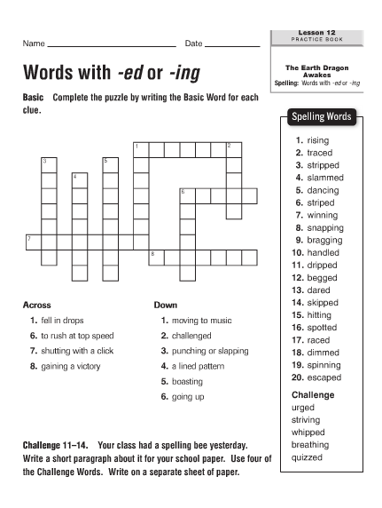

Slide 62
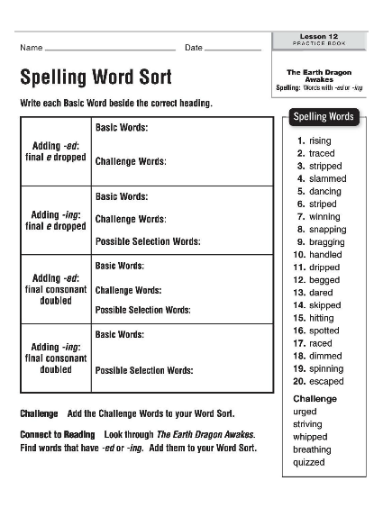

Slide 63
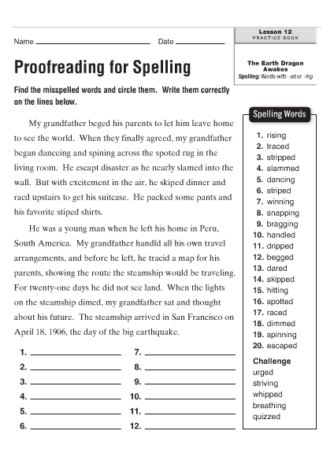

Slide 65
Unit 1: Lesson 13 Spelling
Copyright © 2011 Kelly Mott
Notes:
65

Slide 66
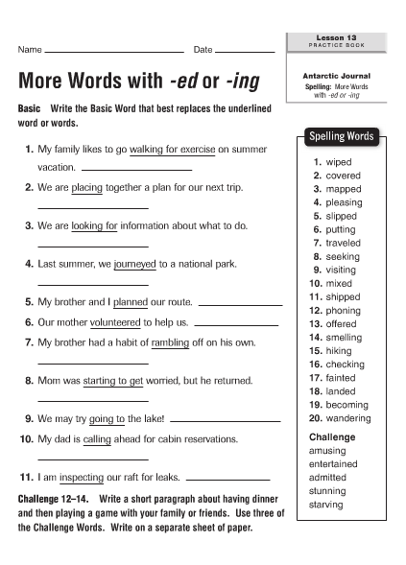

Slide 67
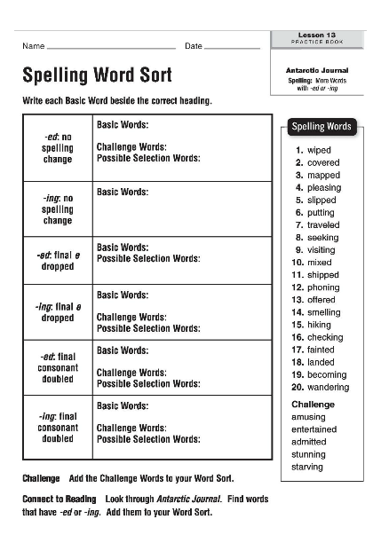

Slide 68
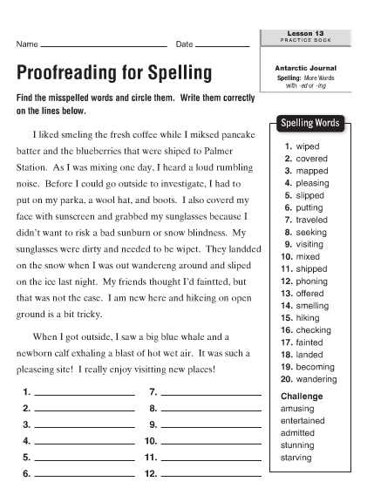

Slide 70
Unit 1: Lesson 14 Spelling
Copyright © 2011 Kelly Mott
Notes:
70

Slide 71
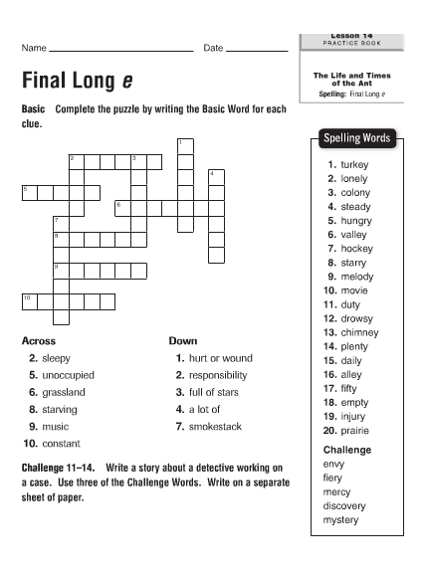

Slide 72
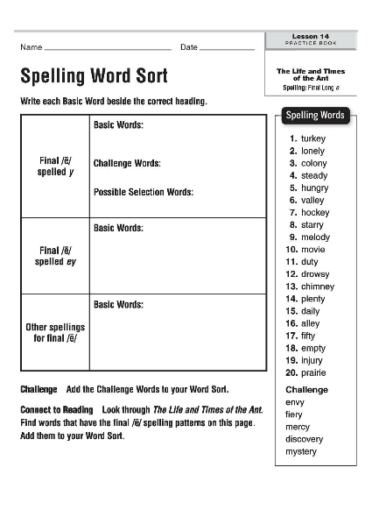

Slide 73
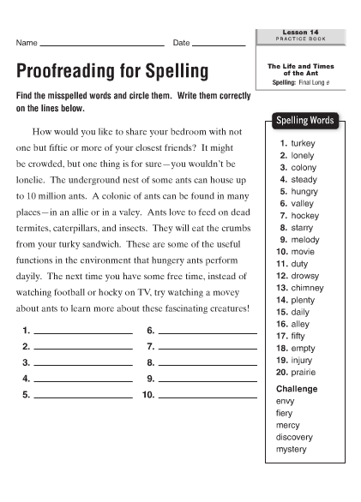

Slide 75
Unit 1: Lesson 15 Spelling
Copyright © 2011 Kelly Mott
Notes:
75

Slide 76
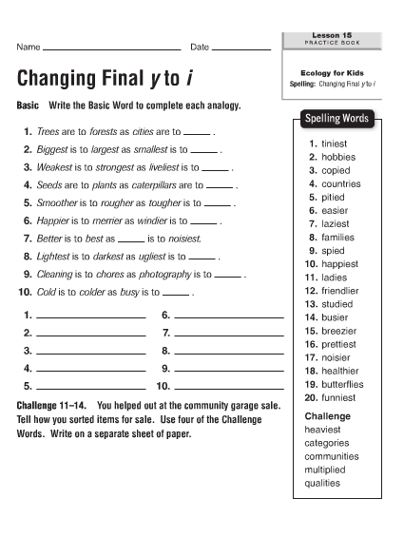

Slide 77
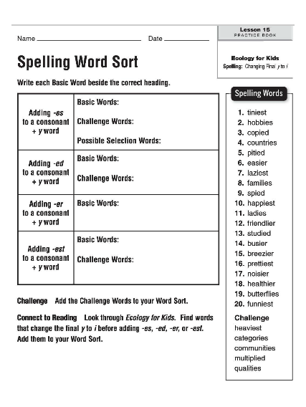

Slide 78
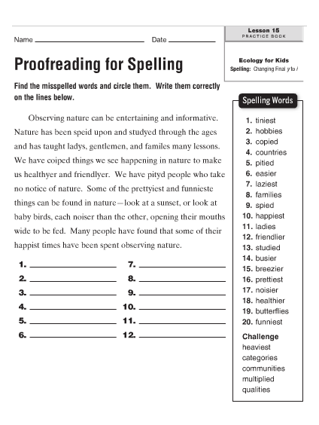

Slide 80
Unit 1: Lesson 16 Spelling
Copyright © 2011 Kelly Mott
Notes:
80

Slide 81
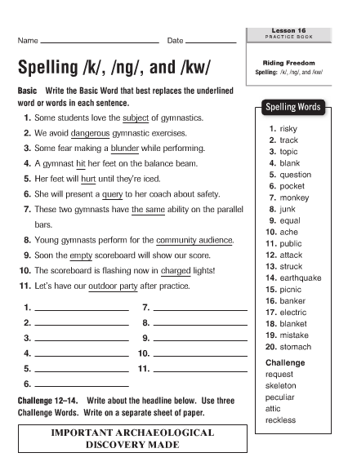

Slide 82
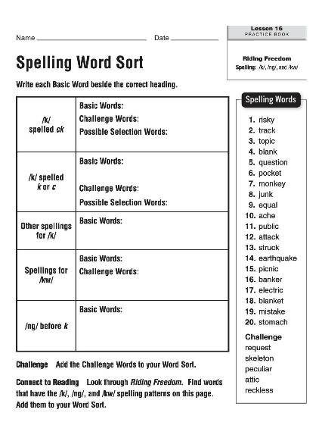

Slide 83
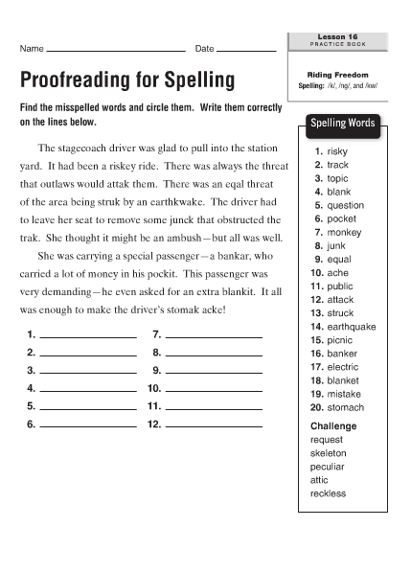

Slide 85
Unit 1: Lesson 17 Spelling
Copyright © 2011 Kelly Mott
Notes:
85

Slide 86
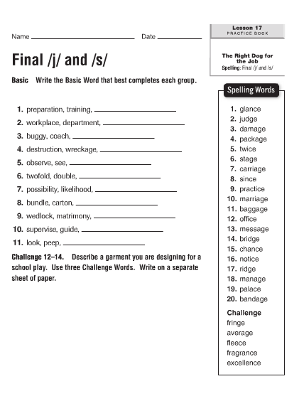

Slide 90
Unit 1: Lesson 18 Spelling
Copyright © 2011 Kelly Mott
Notes:
90

Slide 95
Unit 1: Lesson 19 Spelling
Copyright © 2011 Kelly Mott
Notes:
95

Slide 100
Unit 1: Lesson 20 Spelling
Copyright © 2011 Kelly Mott
Notes:
100

Slide 105
Unit 1: Lesson 21 Spelling
Copyright © 2011 Kelly Mott
Notes:
105

Slide 110
Unit 1: Lesson 22 Spelling
Copyright © 2011 Kelly Mott
Notes:
110

Slide 115
Unit 1: Lesson 23 Spelling
Copyright © 2011 Kelly Mott
Notes:
115

Slide 120
Unit 1: Lesson 24 Spelling
Copyright © 2011 Kelly Mott
Notes:
120

Slide 125
Unit 1: Lesson 25 Spelling
Copyright © 2011 Kelly Mott
Notes:
125

Slide 130
Unit 1: Lesson 26 Spelling
Copyright © 2011 Kelly Mott
Notes:
130

Slide 135
Unit 1: Lesson 27 Spelling
Copyright © 2011 Kelly Mott
Notes:
135

Slide 140
Unit 1: Lesson 28 Spelling
Copyright © 2011 Kelly Mott
Notes:
140

Slide 145
Unit 1: Lesson 29 Spelling
Copyright © 2011 Kelly Mott
Notes:
145

Slide 150
Unit 1: Lesson 30 Spelling
Copyright © 2011 Kelly Mott
Notes:
150

